Slide 1

ITWS
Group 9

Slide 2
Introduction
Rr.com is a website help incoming Freshmen in RPI better prepare the life here.
In Rr.com, you will find a easy way to access almost all the website you need for your semester.

Slide 3
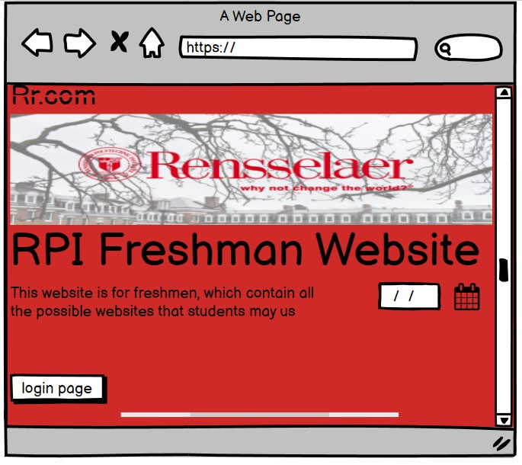
first page mock up

Slide 4
Code for date picker
<h2>Date: <input type="text" id="datepicker"></h2>
<script>
$( function() {
$( "#datepicker" ).datepicker();
} );
</script>

Slide 5
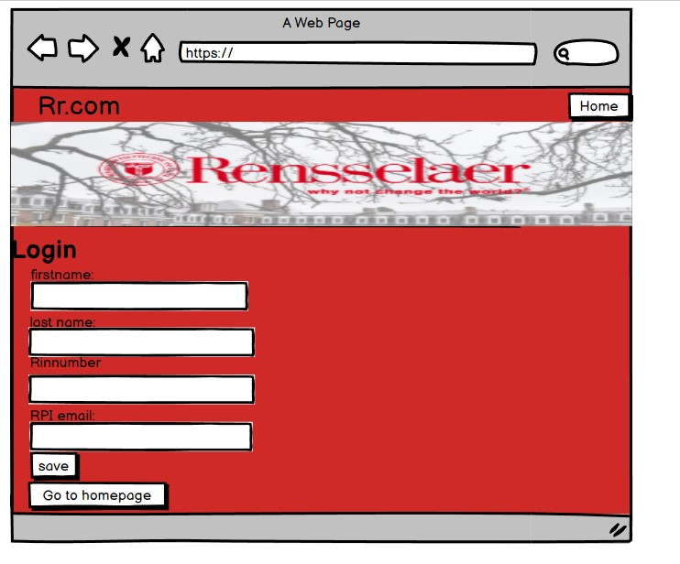
Login in mock up

Slide 6
Login in form code
<form id="addForm" name="addForm" action="" method="get" onsubmit="validate(this);" >
<!-- return validate(this); -->
<fieldset>
<div class="formData">
<label class="field">First Name:</label>
<div class="value"><input type="text" size="60" value="" name="firstName" id="firstName"/></div>
<label class="field">Last Name:</label>
<div class="value"><input type="text" size="60" value="" name="lastName" id="lastName"/></div>
<label class="field">RinNumber</label>
<div class="value"><input type="text" size="60" value="" name="RinNumber" id="RinNumber"/></div>
<label class="field">RPI_email:</label>
<div class="value"><textarea onclick="erase();" rows="4" cols="40" name="email" id="email">Please enter your RPI email</textarea></div>
<input type="submit" value="save" id="save" name="save"/>
</div>
</fieldset>
</form>
<form action="termproject.html">
<input type="submit" value="Go to homepage" />
</form>

Slide 7
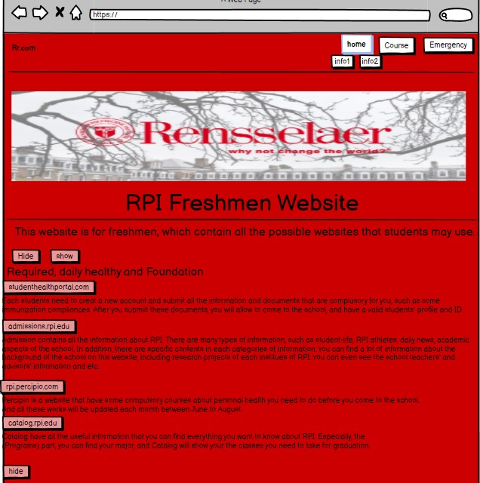
main page
This is the homepage of our website.
It contained all the website your need for semester.

Slide 8
Hide show code
$(document).ready(function(){
$('#basic').click(function(){
alert("The <Courses> is a website that can let students to imitate selecting class on sis");
});
$('#basic2').click(function(){
alert("The <Emergency> is a website that have all the emergent contacts");
});
$("#hideT1").click(function(){
$("#superlink1 p").hide(3000);
});
$("#hideT2").click(function(){
$("#superlink2 p").hide(3000);
});
$("#hideT3").click(function(){
$("#superlink3 p").hide(3000);
});

Slide 9
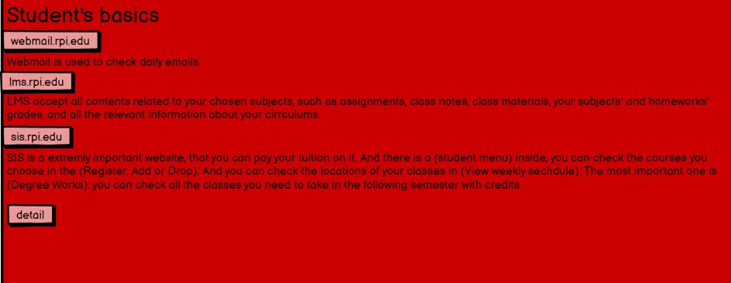
basic mock up

Slide 10
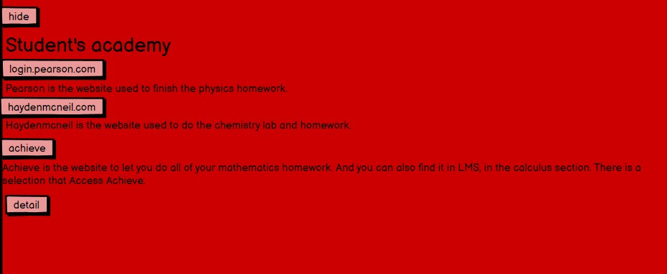
academy mockup
we combine the use of button and link here.
once you press the button, you will go into that page.
when you press detail, it will link you to another page that contain all the specificy way to access the web.

Slide 11
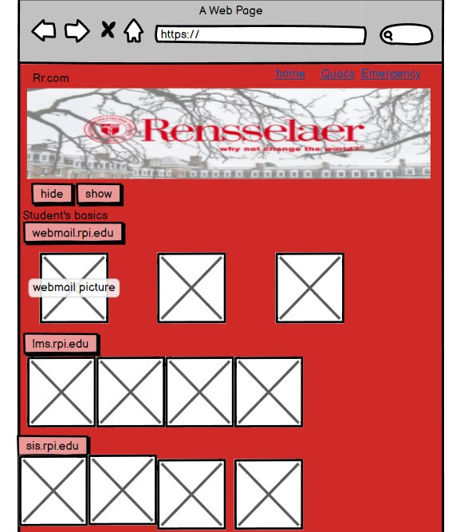
detail mock up
we used hide and show function to display website’s picture
when you enter the button , it will link you to that page.

